Slide 1
Lecture 3.7 Oligopoly – The Stackleberg model

Slide 2
the Stackleberg Model
In the Cournot model, firms choose output simultaneously
but firms might move sequentially instead of simultaneously: e.g. one firm entered the market first, one firm is a recognised industry leader
The Stackelberg model
sequential quantity competition
firms produce identical products
a leader is able to commit to output before the follower(s)
followers choose output to maximise profits after observing the leader’s output
no entry
We will look for a sub-game perfect Nash equilibrium.

Slide 3
Pepsi v coca cola
Pepsi announces that it will wait to see how much Coke ships before determining its quantity.
Pepsi’s executives argue that waiting will give Pepsi more information.
Is this a good idea?

Slide 4
the Stackleberg Model
After the leader moves, competitors learn the leader’s strategy and respond to it
This gives the leader an incentive to produce more:
the extra units produced by the leader reduce the residual demand of its competitors
this reduces the incentive for rivals to produce
the reduced output of rivals increases the leader’s profit
the leader considers this effect when choosing output
This is called the first mover advantage in the Stackelberg model.

Slide 5
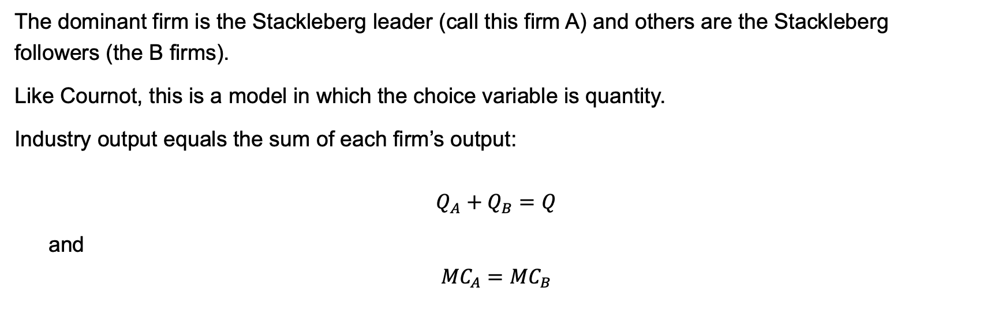
the Stackleberg Model
The dominant firm is the Stackleberg leader (call this firm A) and others are the Stackleberg followers (the B firms).
Like Cournot, this is a model in which the choice variable is quantity.
Industry output equals the sum of each firm’s output:
$$Q_{A}+Q_{B}=Q$$
and
$${MC}_{A}={MC}_{B}$$

Slide 6
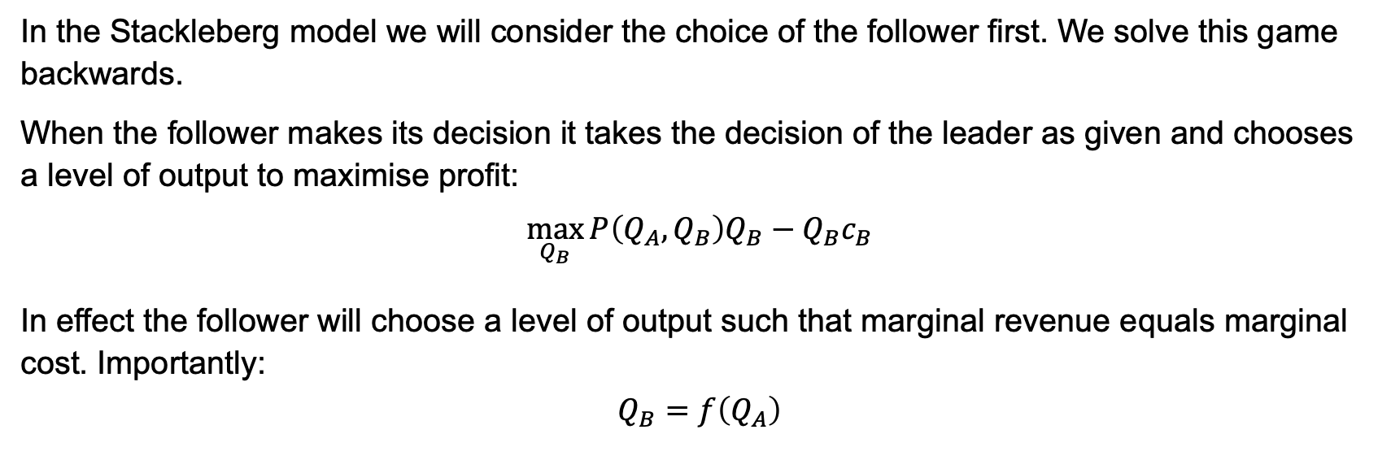
the Stackleberg Model
In the Stackleberg model we will consider the choice of the follower first. We solve this game backwards.
When the follower makes its decision it takes the decision of the leader as given and chooses a level of output to maximise profit:
$$\max_{Q_{B}}{P\left(Q_{A},Q_{B}\right)Q_{B}}−Q_{B}c_{B}$$
In effect the follower will choose a level of output such that marginal revenue equals marginal cost. Importantly:
$$Q_{B}=f\left(Q_{A}\right)$$

Slide 7
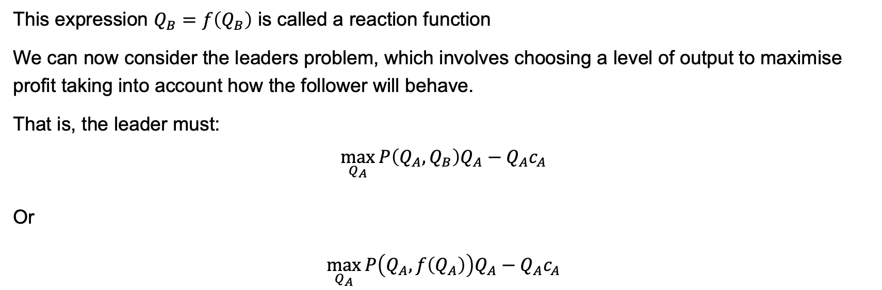
the Stackleberg Model
This expression $Q_{B}=f\left(Q_{B}\right)$ is called a reaction function
We can now consider the leaders problem, which involves choosing a level of output to maximise profit taking into account how the follower will behave.
That is, the leader must:
$$\max_{Q_{A}}{P\left(Q_{A}, Q_{B}\right)Q_{A}}−Q_{A}c_{A}$$
Or
$$\max_{Q_{A}}{P\left(Q_{A},f\left(Q_{A}\right)\right)Q_{A}}−Q_{A}c_{A}$$

Slide 8
the Stackleberg Model
Consider the following demand and cost conditions:
demand: P(Q) = 40−Q, where Q = Q₁+Q₂
costs: C(Q_{i}) = 4Q_{i} , i = 1, 2
By backward induction, we first solve Firm 2’s problem:
Firm 2 chooses an optimal output given the output of Firm 1. This is equivalent to finding the reaction function in the Cournot model
Profits: π₂ = (40−Q₁−Q₂)Q₂−4Q₂
Solve FOCs to find the reaction function:
0 = 40−Q₁−2Q₂−4
Q₂ =18−Q₁/2 ≡ r₂(Q₁)

Slide 9
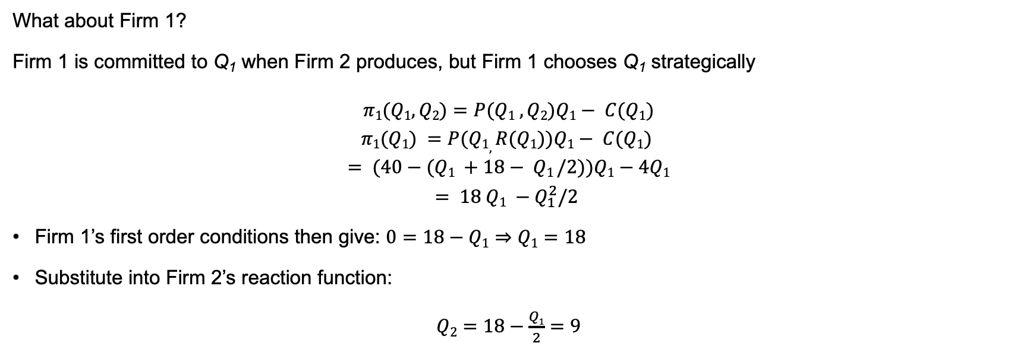
the Stackleberg Model
What about Firm 1?
Firm 1 is committed to Q₁ when Firm 2 produces, but Firm 1 chooses Q₁ strategically
$$π1(Q1,Q2)=P(Q1 , Q2)Q1− C(Q1)$$
$$π1(Q1) =P(Q1, R(Q1))Q1− C(Q1)$$
$$= (40−(Q1 +18− Q1 /2))Q1−4Q1$$
$$= 18 Q1 −Q_{1}^{2}/2$$
Firm 1’s first order conditions then give: $0=18−Q1$ ⇒ $Q1=18$
Substitute into Firm 2’s reaction function:
$Q2=18−\frac{Q1}{2}=9$

Slide 10
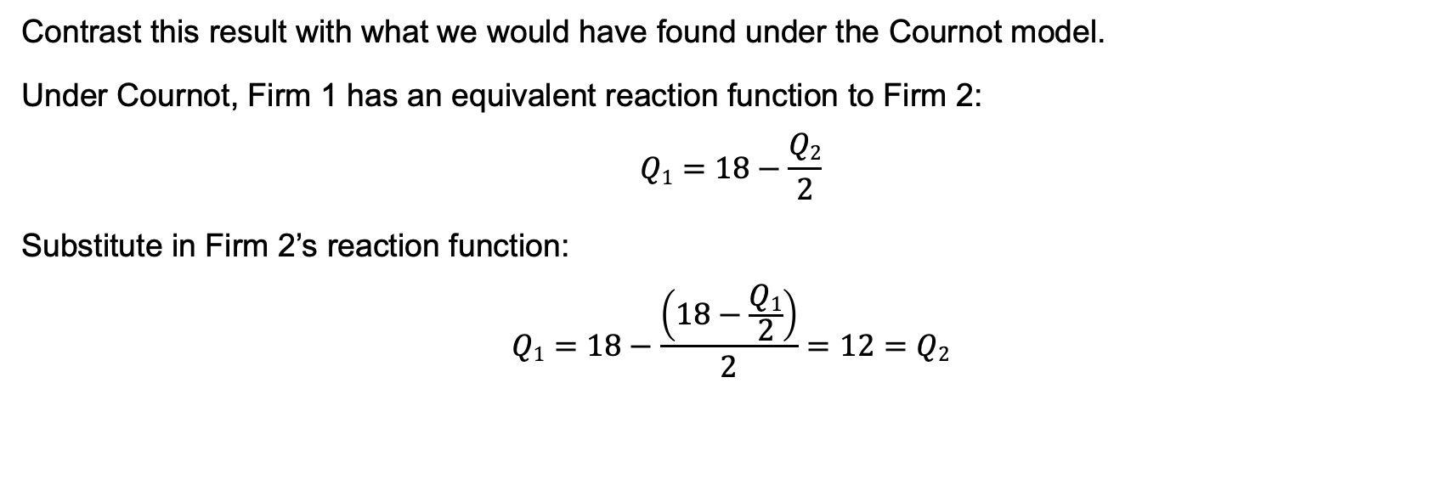
Stackleberg vs cournot
Contrast this result with what we would have found under the Cournot model.
Under Cournot, Firm 1 has an equivalent reaction function to Firm 2:
$$Q1=18−\frac{Q2}{2}$$
Substitute in Firm 2’s reaction function:
$$Q1=18−\frac{\left(18−\frac{Q1}{2}\right)}{2}=12=Q2$$

Slide 11
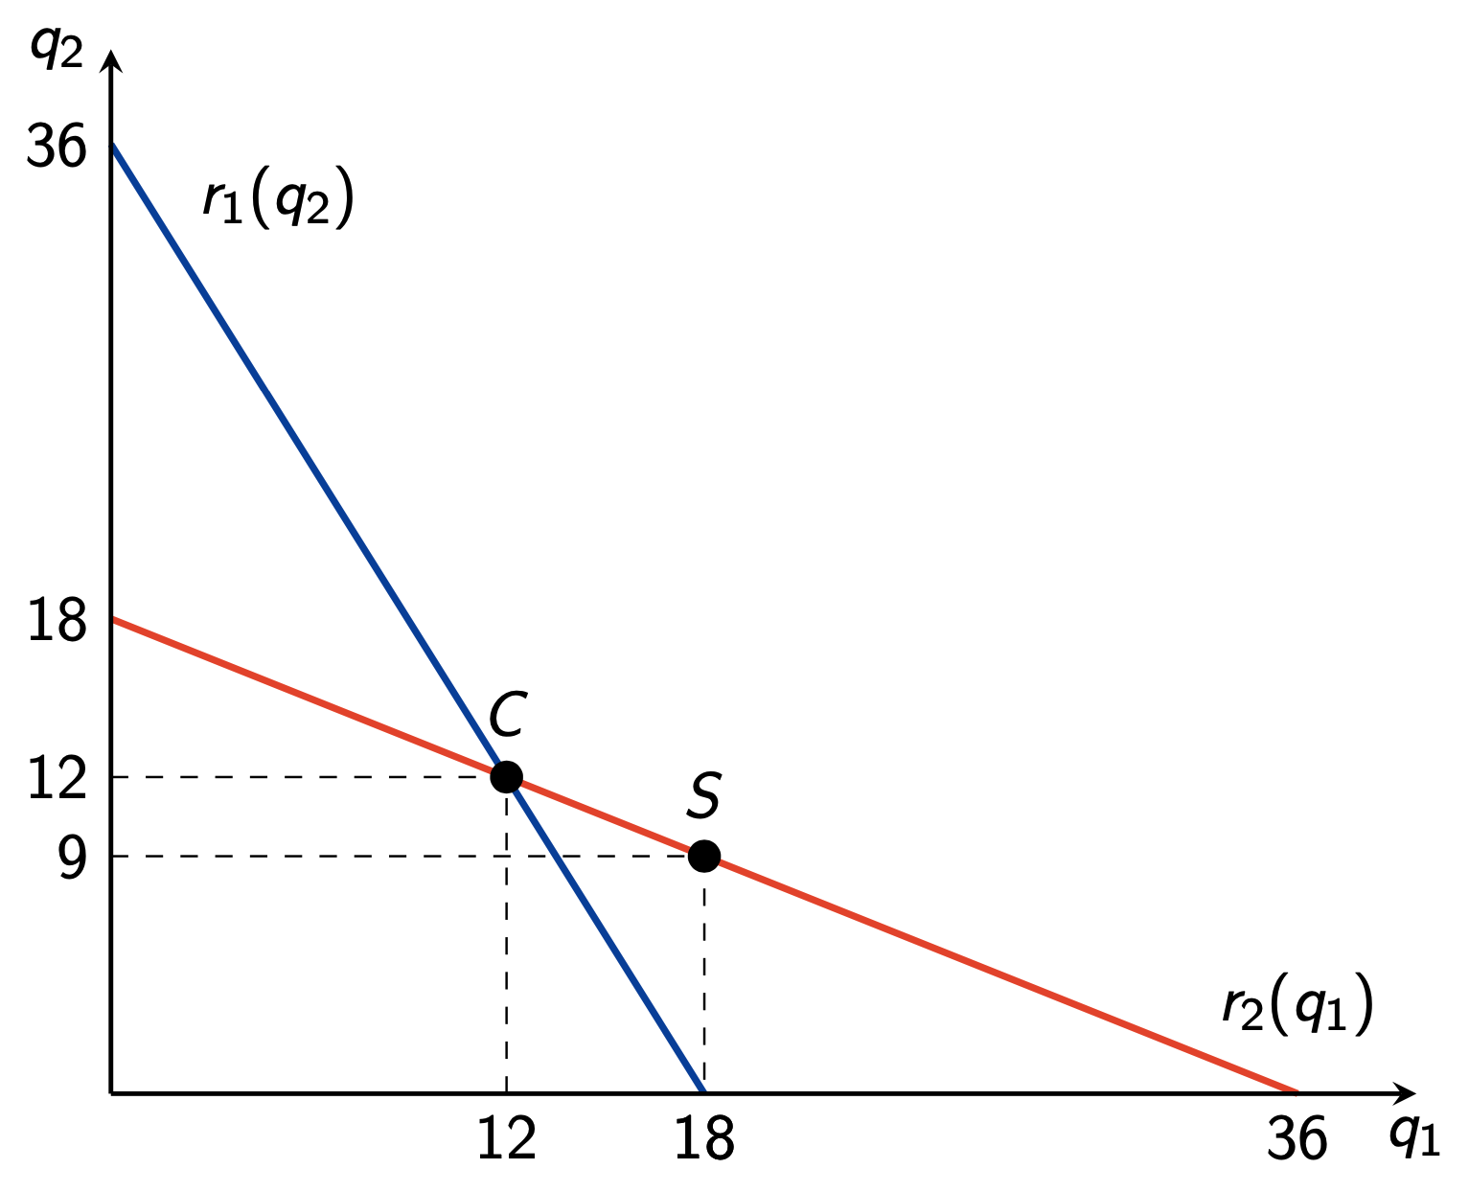
Stackleberg vs cournot

Slide 12
the Stackleberg Model
What is going on here?
Firm 1 wants to produce more to discourage Firm 2 from producing. How much more depends on the slope of demand and the slope of the reaction function.
Questions
Is Firm 1 operating on their reaction function?
Would Firm 1 be better off changing their output after observing Q₂?
What if Firm 2 anticipates this?

Slide 13
the Stackleberg Model
Players can benefit from the ability to commit
the leader has a “first-mover advantage”
the leader produces more than the Cournot equilibrium output
the leader receives a larger market share and higher profits
The follower
produces less than the Cournot equilibrium output
receives a smaller market share and lower profits

